Slide 1
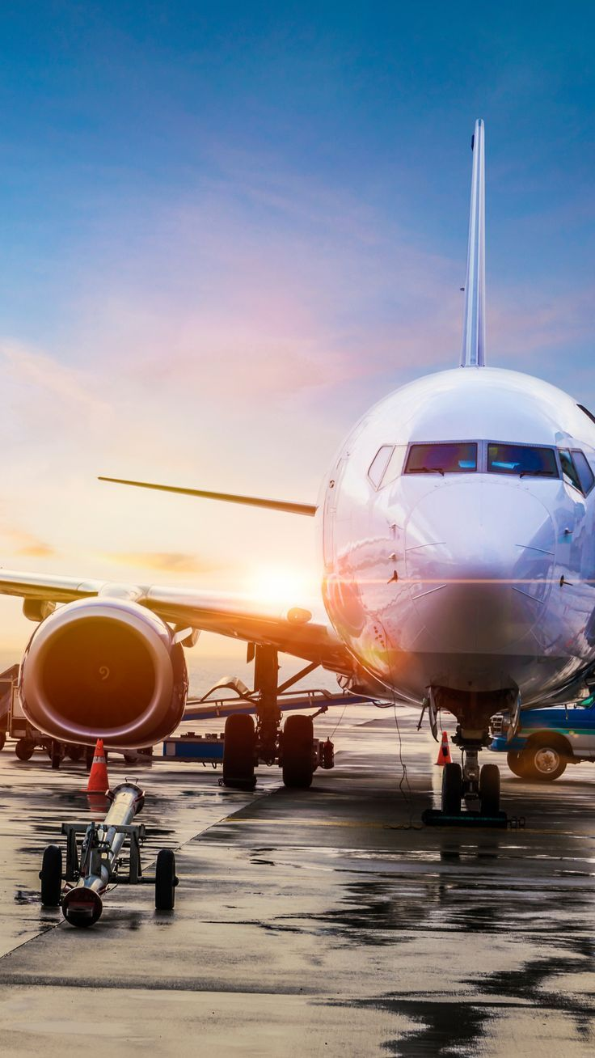
Indian Airline Project Analysis
Presented By:- Ankit Rajak
Project File:-Indian Airline Project

Slide 2
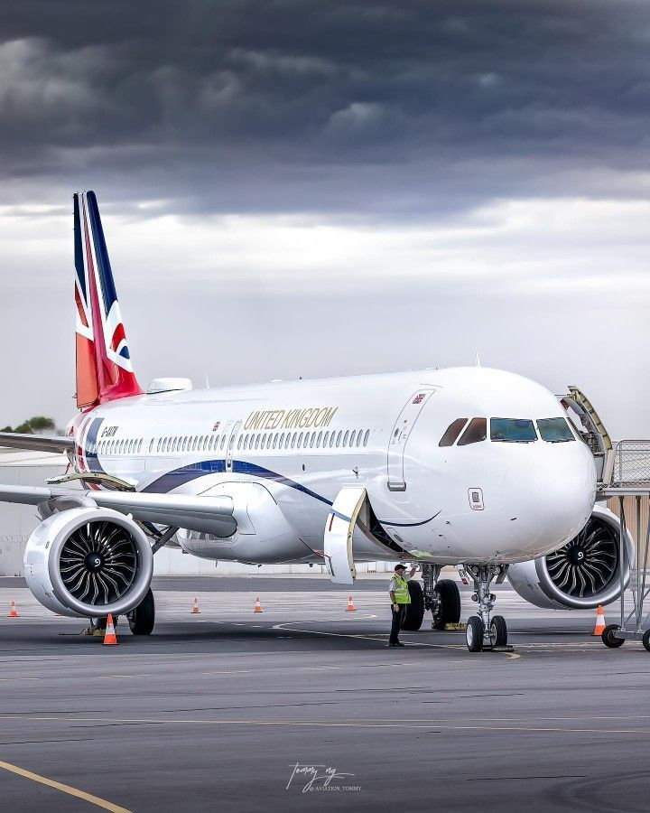
Introduction:-
The India airline industry is a rapidly growing sector, playing a vital role in the country’s transportation network and economic development. With increasing domestic and international air travel, it has become crucial to analyze key performance indicators of the airline industry to understand trends, challenges, and opportunities. This project focuses on analyzing various aspects of the Indian airline sector, including flight delays, cancellations, on-time performance, customer satisfaction, and the impact of factors like weather, operational efficiency, and airline management on service delivery.
By exploring data related to airlines, routes, passenger volumes, and operational metrics, this project aims to provide a comprehensive overview of the industry's performance. It identifies patterns in delays, passenger preferences, and peak travel periods while evaluating the performance of different airlines operating within India. The ultimate goal of this project is to uncover insights that can help airlines improve their services, enhance passenger experience, and optimize operations for long-term growth and sustainability.

Slide 3
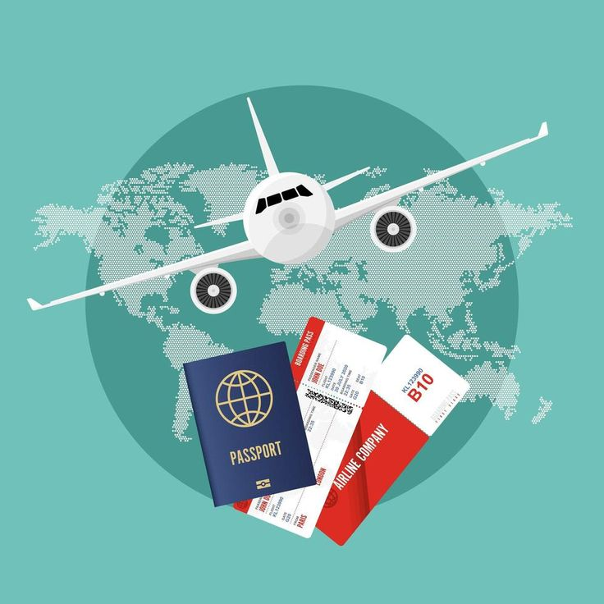
Objective:-
The objective of the Indian airline industry analysis is to provide a comprehensive understanding of the current landscape, challenges, and opportunities within the sector. The analysis aims to evaluate the performance of major domestic and international airlines operating in India by examining key factors such as market share, revenue, profitability, and passenger traffic trends. It seeks to identify the impact of regulatory frameworks, government policies, and economic conditions on the industry's growth and sustainability.
Additionally, the analysis will focus on understanding the competitive dynamics, including the rise of low-cost carriers (LCCs) and their influence on pricing strategies, service quality, and consumer preferences. The study will assess the challenges posed by infrastructure limitations, fuel price fluctuations, and environmental concerns, as well as the role of technological advancements in enhancing operational efficiency.
The objective is also to explore future growth prospects, including the potential for expanding routes, increasing air connectivity to regional areas, and tapping into the growing demand for air travel in tier-2 and tier-3 cities. By providing insights into these areas, the analysis aims to offer strategic recommendations for stakeholders, including airlines, policymakers, and investors, to navigate the evolving landscape and foster sustainable growth in the Indian airline industry.

Slide 4
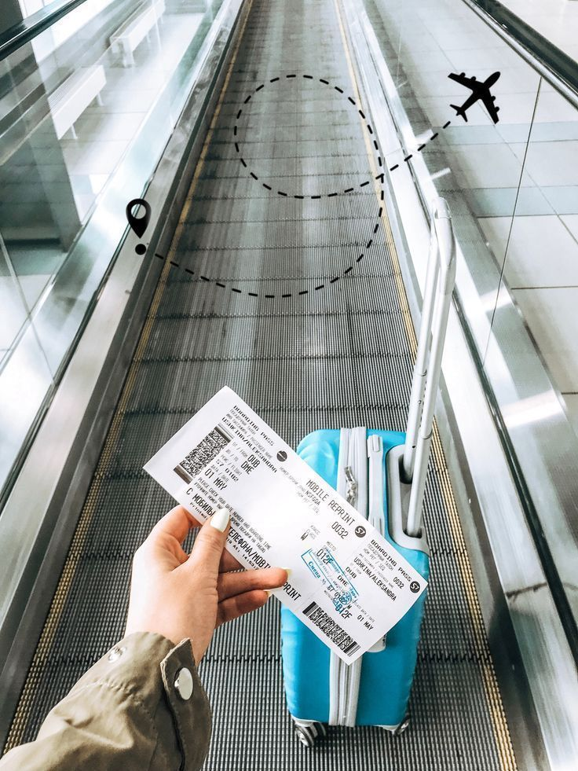
Key Questions:-
1.Which airline has the highest average price?
2.How does the price vary with the class of travel?
3.Is there a correlation between flight duration and price?
4.Which routes are the most popular?
5.How does the price vary across different source and destination cities?
6.Departure and Arrival Time Counts?
7.Number of Stops by Destination City?
8.Average Flight Duration by Airline?

Slide 5
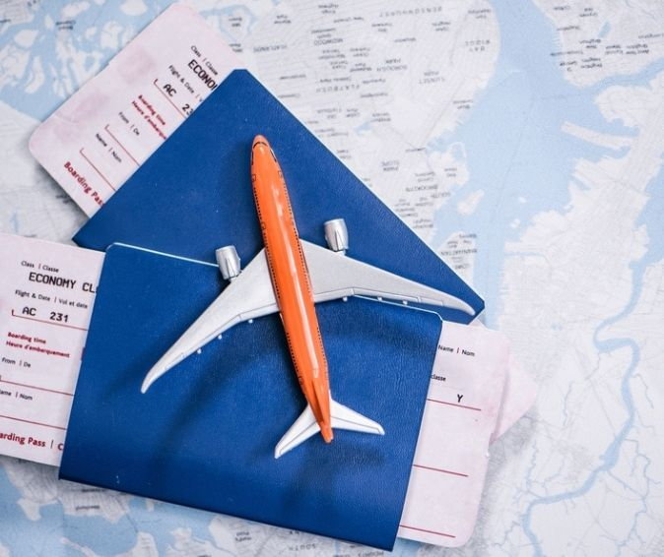
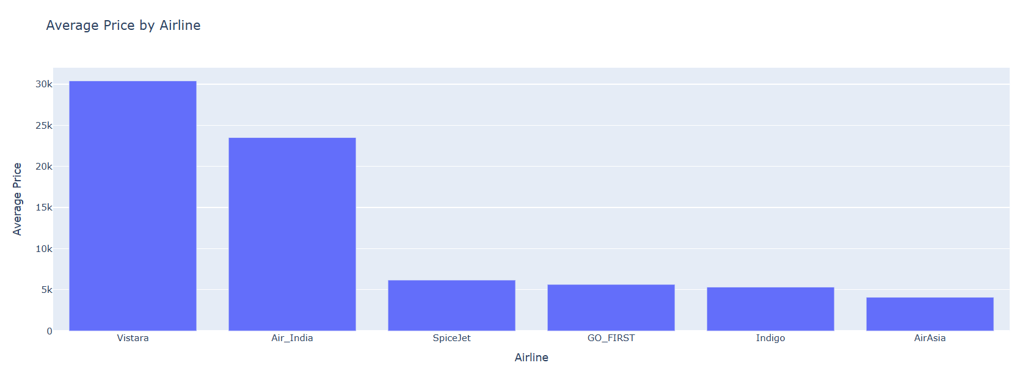
1.Which airline has the highest average price?
Observation:-As of recent data, Vistara is often considered to have the highest average ticket price among Indian airlines, primarily due to its premium full-service offerings. Vistara provides enhanced in-flight services, including business and premium economy classes, which contribute to its higher pricing compared to low-cost carriers.

Slide 6
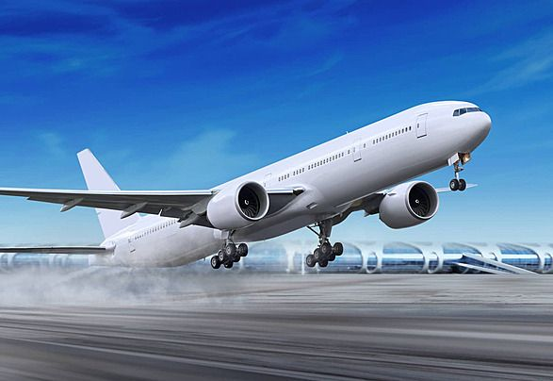
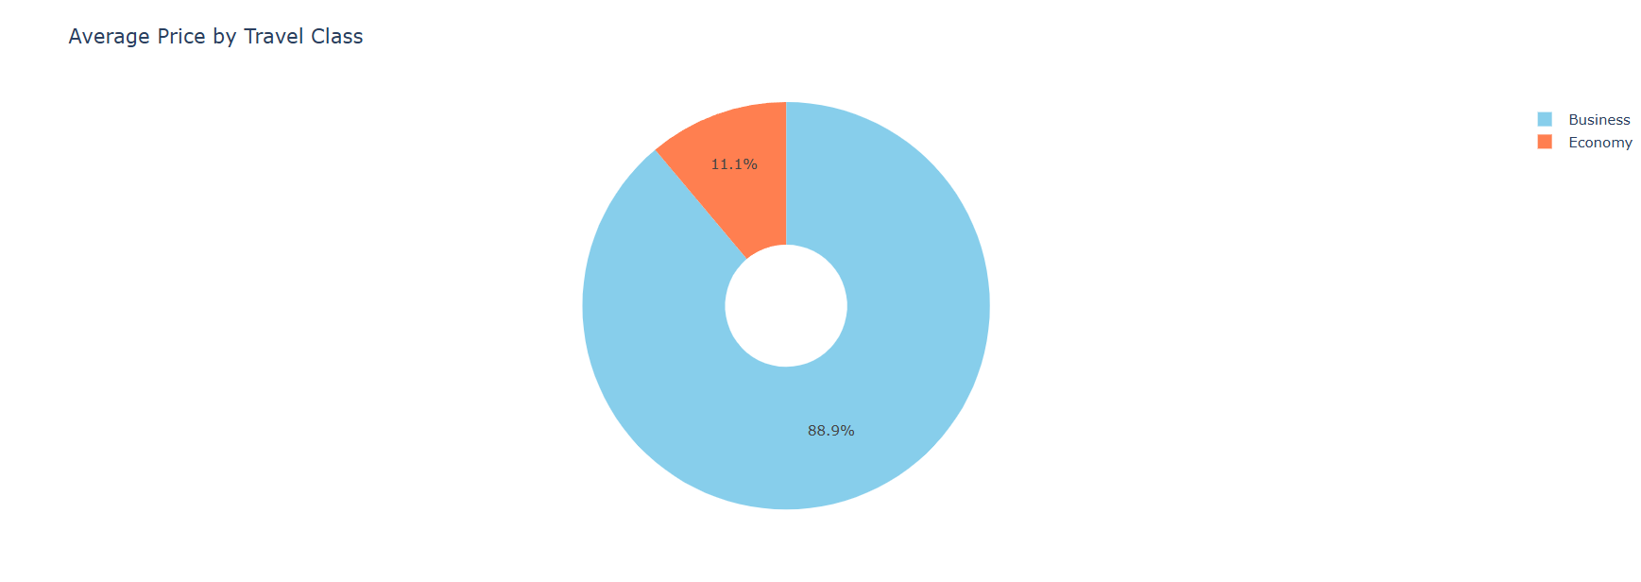
2.How does the price vary with the class of travel?
Observation:-Airfare varies significantly by class of travel. Economy class offers the lowest prices with basic services, while Premium Economy is slightly more expensive, providing extra legroom and perks. Business class commands a higher price due to enhanced comfort, meals, and amenities. First class is the most expensive, offering luxury services.

Slide 7
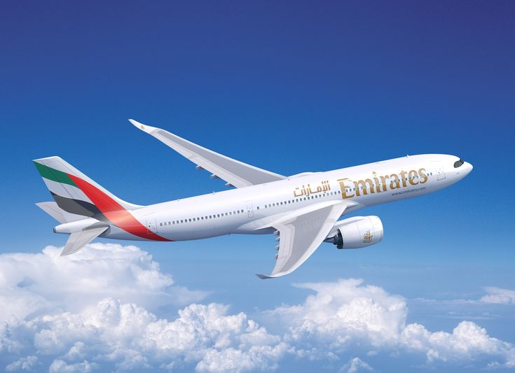
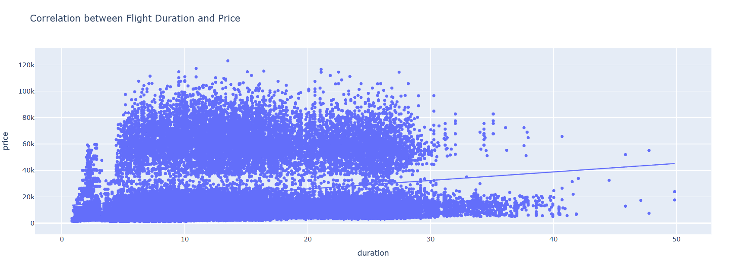
3.Is there a correlation between flight duration and price?
Observation:-there is generally a positive correlation between flight duration and price. Longer flights typically have higher fares due to increased fuel consumption, operational costs, and crew expenses. However, factors like demand, booking time, and airline pricing strategies can also affect the price independently of flight duration.

Slide 8
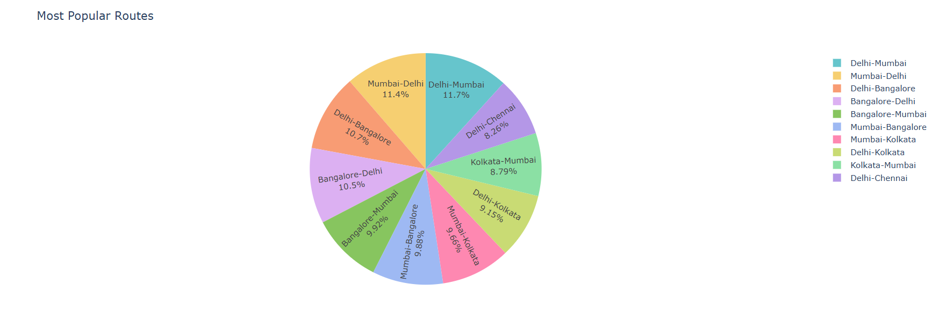
4.Which routes are the most popular?
Observation:-In India, the most popular airline routes are typically between major metropolitan cities. Routes like Delhi-Mumbai, Bengaluru-Delhi, Mumbai-Bengaluru, and Chennai-Delhi see the highest passenger traffic due to business, tourism, and economic activities. These routes are frequently served by multiple airlines with numerous daily flights.

Slide 9
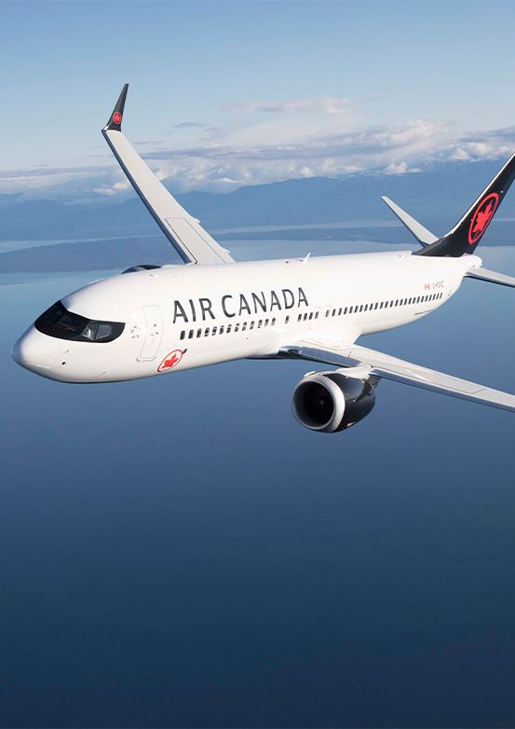
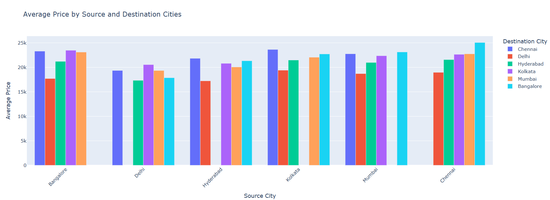
5.How does the price vary across different source and destination cities?
Observation:-Airfares vary widely across different source and destination cities based on factors like demand, distance, and competition. Routes between major cities like Delhi-Mumbai tend to have competitive, lower fares due to high demand, while flights to less popular or remote locations, such as tier-2 or tier-3 cities, often have higher prices.

Slide 10
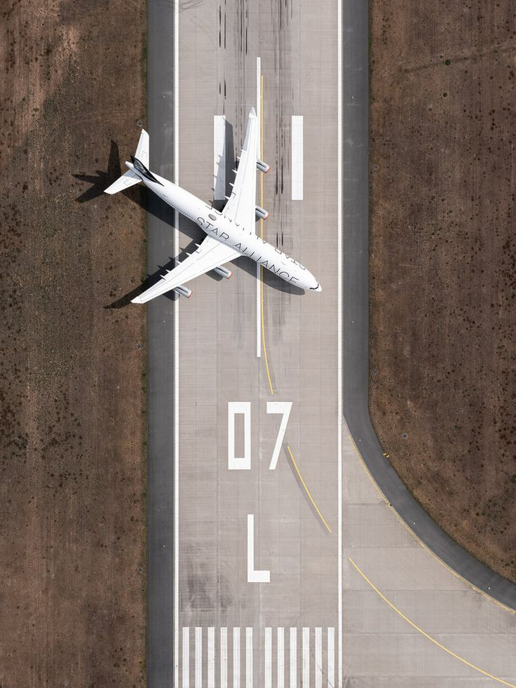
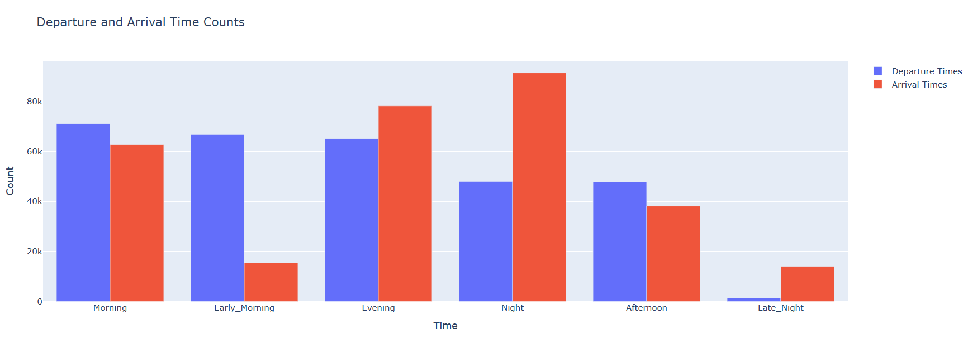
6.Departure and Arrival Time Counts?
Observation:-Flight departures and arrivals are typically concentrated during peak hours. Morning (6 AM–10 AM) and evening (5 PM–9 PM) slots witness the highest counts due to business and leisure travel preferences. Midday and late-night flights tend to have fewer departures and arrivals, catering to specific demand or longer routes.

Slide 11
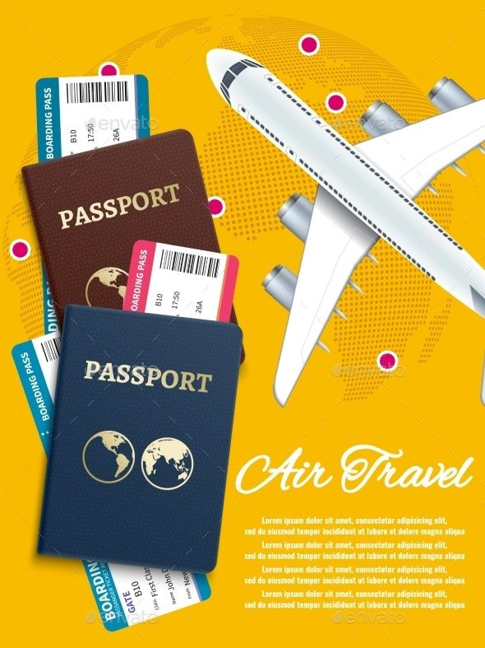
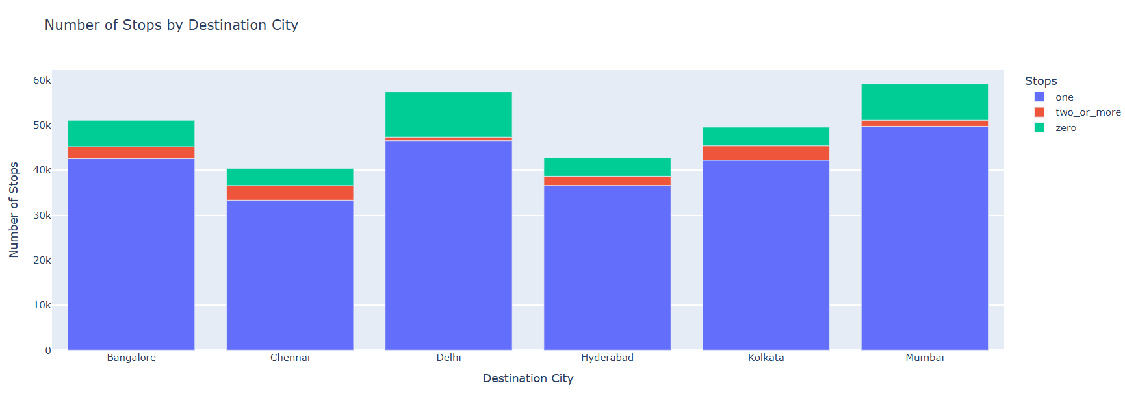
7.Number of Stops by Destination City?
Observation:-The number of stops on a flight to a destination city depends on the route's distance and airline schedules. Major cities like Delhi, Mumbai, and Bengaluru often have direct flights, while smaller cities or remote locations may require one or more stops, especially for long-distance or international flights.

Slide 12
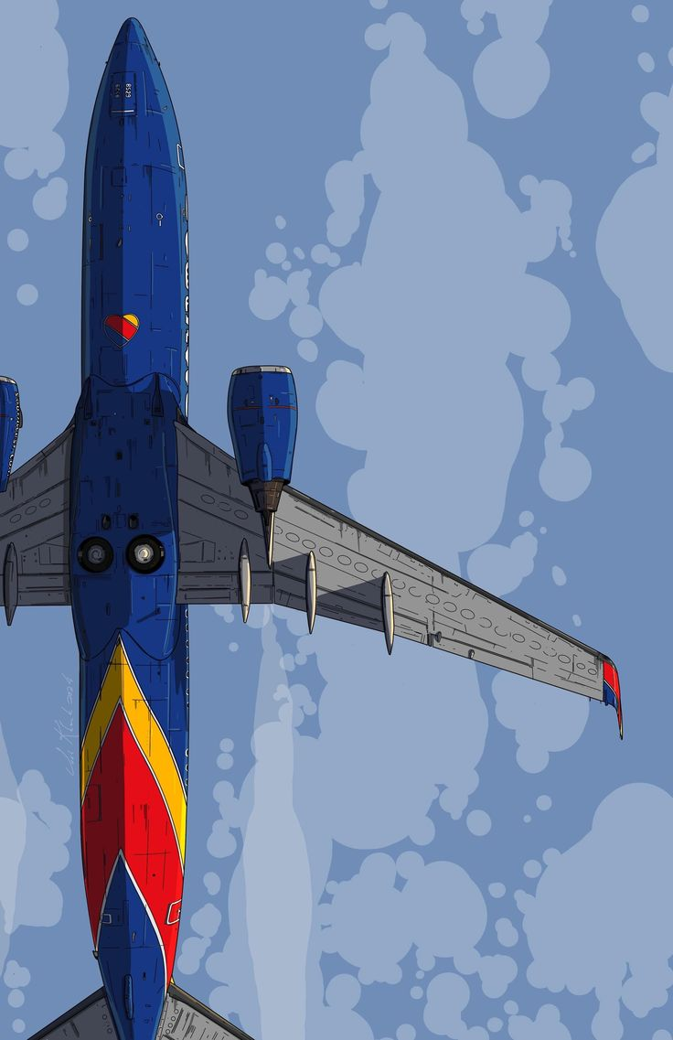
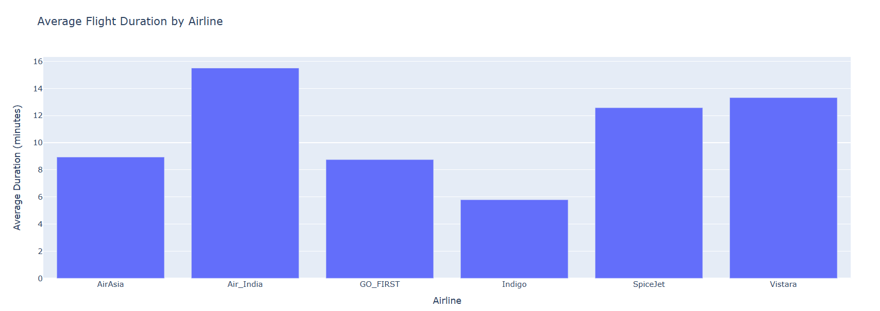
8.Average Flight Duration by Airline?
Observation:-Average flight duration varies by airline depending on the routes they serve. Domestic low-cost carriers like IndiGo and SpiceJet typically operate shorter flights (1-3 hours). Full-service carriers like Vistara and Air India have longer average durations due to a mix of domestic and international routes, which extend beyond 4 hours.

Slide 13
Conclusion:-
The Indian airline industry is characterized by a dynamic mix of low-cost carriers and full-service airlines, each catering to diverse consumer segments. The analysis reveals key insights into pricing strategies, the influence of travel class, and the impact of flight duration and city pairs on fares. Popular routes between major metropolitan cities remain competitive with frequent flights and lower fares, while routes to tier-2 and tier-3 cities often command higher prices.
Challenges such as rising fuel costs, infrastructure limitations, and regulatory hurdles continue to impact the industry, but the growing demand for air travel, particularly from regional markets, presents opportunities for expansion. To sustain growth, airlines must focus on optimizing operational efficiency, leveraging technological advancements, and adapting to evolving passenger preferences. Strategic recommendations from the analysis aim to help airlines, policymakers, and investors navigate the complexities of the Indian aviation market and foster long-term sustainability.

Slide 14
Thank You

